Slide 1
REST API Deep Dive & Simplifying Client-Side Development with Breeze!
Andrew Connell
github.com/andrewconnell/pres-sp15rest-breeze

Slide 2

Andrew Connell
@andrewconnell
www.andrewconnell.com
Co-Host” Microsoft Cloud Show
@mscloudshow
www.MicrosoftCloudShow

Slide 3
Topics
SharePoint 2013 REST API
Office 365 REST API
Batching Requests for Performance
Incorporating Breeze into Client-Side Apps

Slide 4
SharePoint 2013 REST API

Slide 5
SharePoint 2013 REST API
Introduced in SharePoint 2010
http://…/_vti_bin/listdata.svc
Dramatically expanded in v15
More than just lists
Nearly full feature parity to CSOM
Based on OData v3.0 at release & on-prem
SharePoint Online updated to OData v4.0

Slide 6
Why REST API vs. CSOM?
Full control over the payload
Standard response types
Consumers not limited to supported technologies on specific platforms

Slide 7
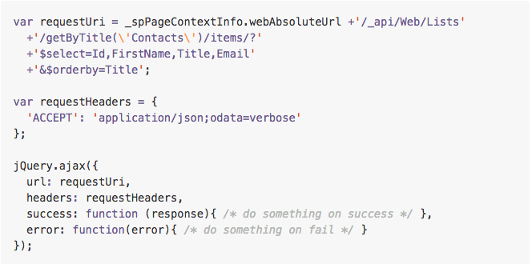
Getting All Items, Sorted

Slide 8
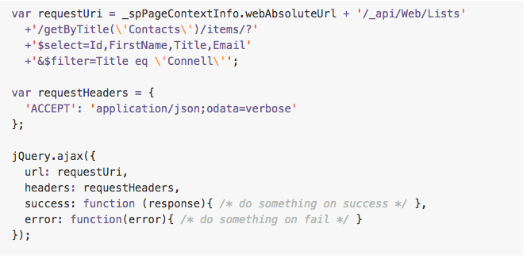
Getting Specific Item(s)

Slide 9
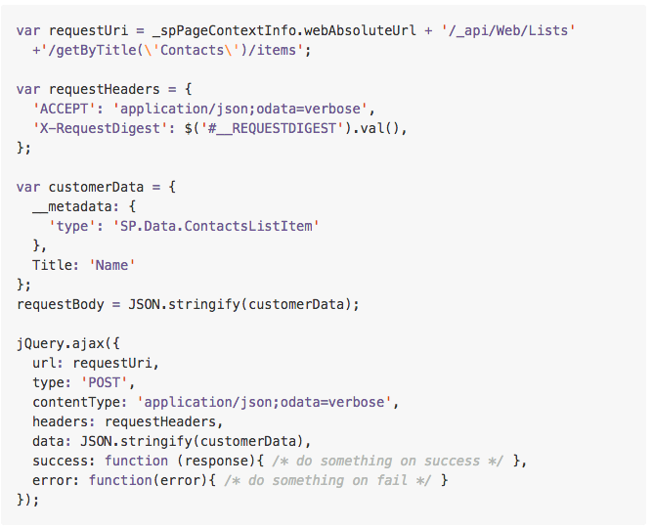
Creating an Item

Slide 10
Updating an Item

Slide 11
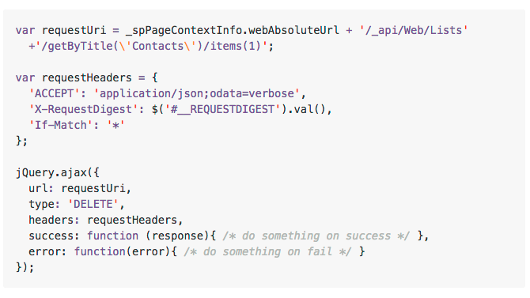
Deleting an Item

Slide 12
Office 365 REST API

Slide 13
Office 365 REST API
Released in November 2014
Access to tons of data in Office 365
Sites (SharePoint)
Exchange (Contacts, Calendar & Mail)
Files (OneDrive for Business)
…
OData v4.0 compliant
SDKs for .NET, WinJS, iOS, Android, etc.

Slide 14
Batching with REST

Slide 15
REST is More Chatty than CSOM
Each action is sent as a separate request
CSOM allows for multiple requests to be sent as one
Requests are expensive & slow your app

Slide 16
Batching Support Added to O365
Office 365 REST APIs shipped with support for support with REST APIs
Batching requests with REST support added to SharePoint Online late 2014
Send multiple write & read operations in one HTTP request
SharePoint 2013 on-premises – not supported

Slide 17
Exploring the Impact

Slide 18
Overview - Batch Request
BATCH REQUEST
CHANGESET - HTTP POST
CHANGESET - HTTP PATCH
CHANGESET - HTTP DELETE
HTTP GET

Slide 19
Overview - Batch Response
BATCH RESPONSE
CHANGESET RESPONSE
CHANGESET RESPONSE
CHANGESET RESPONSE
HTTP GET RESPONSE

Slide 20
Exploring Batch Requests & Responses

Slide 21
More on SharePoint Batching
SharePoint REST API Batching
Understanding Batching Requests http://aconn.me/14lmhyz
Exploring Batch Requests, Responses & Changesets http://aconn.me/14lmhhV
SharePoint REST Batch Executor
https://github.com/SteveCurran/sp-rest-batch-execution

Slide 22
BReeze - Simplifying Client-Side Development

Slide 23
Introducing Breeze
Think Entity Framework in JavaScript
LINQ-style syntax
All network calls yield async promises
Query & navigate to related entities
Query locally with automatic client-side caching
Client-side entity validation
Client-side change tracking

Slide 24
Requires Extra Setup to Work
SharePoint’s REST API metadata is huge
You define metadata for what you want
SharePoint’s REST API uses non-standard OData stuff
X-RequestDigest, X-Merge-Method & complex data types

Slide 25
Get Breeze + SharePoint DSA
Breeze data service adapters
Take control over requests & responses
SharePoint DSA - v0.10.0
SharePoint 2010 /_vti_bin/listdata.svc
SharePoint 2013 on-premises
SharePoint Online (Office 365)
NuGet & Bower Packages
http://aconn.me/sp-rest-breeze-dsa

Slide 26
BReeze - Simplifying Client-Side Development

Slide 27

Thank you for attending!
Andrew Connell
@andrewconnell
www.andrewconnell.com
github.com/andrewconnell/pres-sp15rest-breeze

